Slide 1
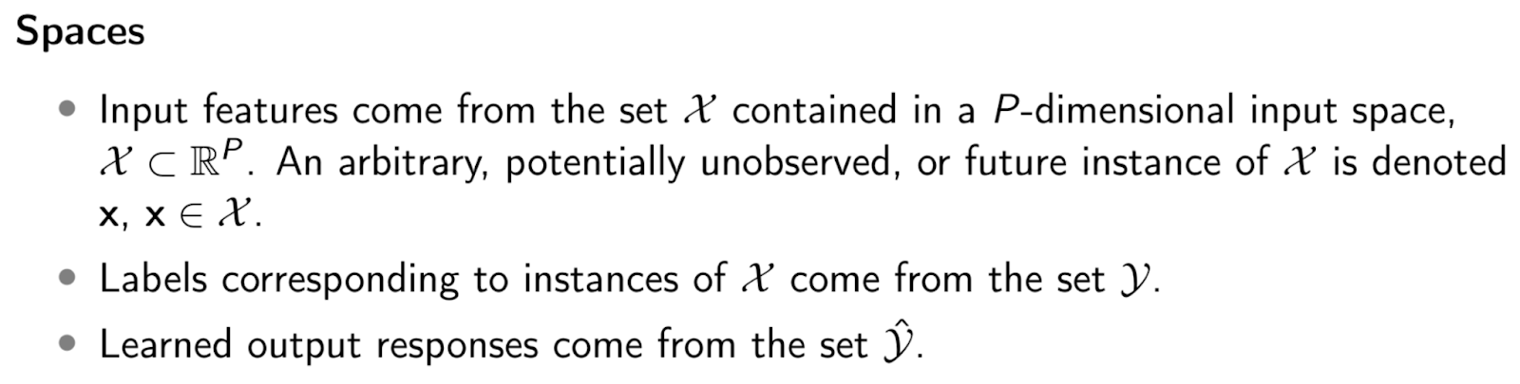
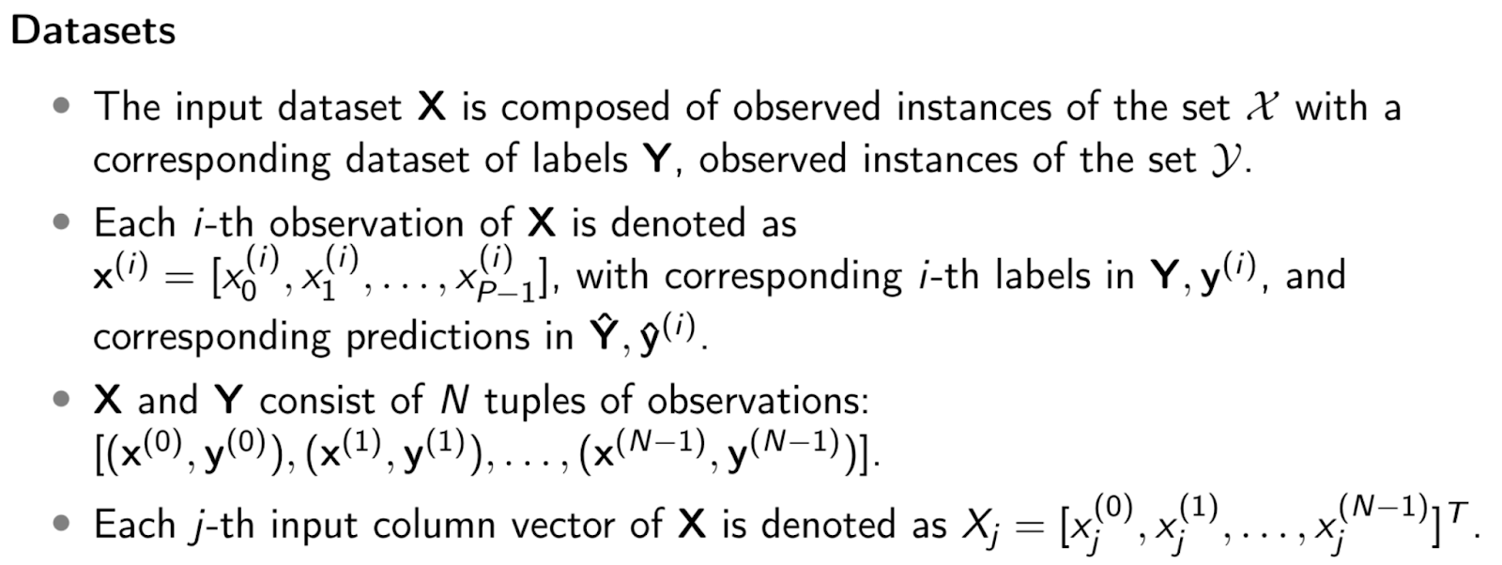
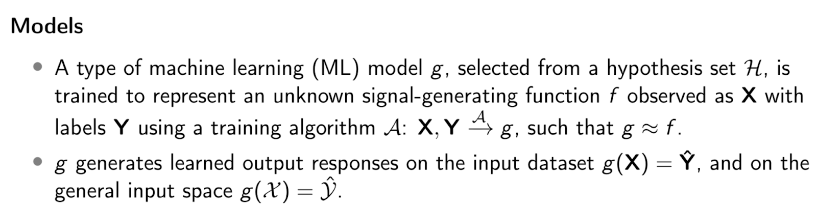
f(X ), true, unknown
g(X ), approximate, learned
=
Y
~
Y
=
Ŷ
P, number of features (columns)
x₀⁽⁰⁾
P input features are indexed from 0 to P-1.
x_{P-1}⁽⁰⁾
y⁽⁰⁾
ŷ⁽⁰⁾
X
Recorded instances of X
Y
Recorded instances of Y
Ŷ
Recorded instances of Ŷ
N, number of instances (rows)
N input instances are indexed from 0 to N-1.
x₀^{(N-1)}
x_{P-1}^{(N-1)}
y^{(N-1)}
ŷ^{(N-1)}
X , all possible input instances
Y, all possible target values
Ŷ , all possible prediction
values
This diagram assumesY ∈ ℝ¹ and Ŷ ∈ ℝ¹. A single target is a common scenario. However, algorithms may learn multiple targets and multiple tasks simultaneously.

